Slide 1
Micro Credit Loan Prediction

Slide 2
Problem Statement-
Our client is in Telecom Industry. They are collaborating with an MFI to provide micro-credit on mobile balances to be paid back in 5 days. Build a model which can be used to predict in terms of a probability for each loan transaction, whether the customer will be paying back the loaned amount within 5 days of insurance of loan. In this case, Label ‘1’ indicates that the loan has been payed i.e. Non- defaulter, while, Label ‘0’ indicates that the loan has not been payed i.e. defaulter.

Slide 3
Problem Understanding-
A Microfinance Institution (MFI) is an organization that offers financial services to low income populations. MFS becomes very useful when targeting especially the unbanked poor families living in remote areas with not much sources of income. Many microfinance institutions (MFI), experts and donors are supporting the idea of using mobile financial services (MFS) which they feel are more convenient and efficient, and cost saving, than the traditional high-touch model used since long for the purpose of delivering microfinance services.
We are working with one such client that is in Telecom Industry. They are a fixed wireless telecommunications network provider. They are collaborating with an MFI to provide micro-credit on mobile balances to be paid back in 5 days. The Consumer is believed to be defaulter if he deviates from the path of paying back the loaned amount within the time duration of 5 days. For the loan amount of 5 (in Indonesian Rupiah), payback amount should be 6 (in Indonesian Rupiah), while, for the loan amount of 10 (in Indonesian Rupiah), the payback amount should be 12 (in Indonesian Rupiah).

Slide 4
EDA Steps and Visualization

Slide 5
The provided sample data from the client database and saved in a dataframe
The shape of the dataframe is checked-
There are 209593 rows and 37 columns
The columns are as follows-
Unnamed: 0
Label
Msisdn
Aon
daily_decr30
daily_decr90
Rental30
Rental90
last_rech_date_ma
last_rech_date_da
last_rech_amt_ma
cnt_ma_rech30
fr_ma_rech30
sumamnt_ma_rech30
medianamnt_ma_rech30
Medianmarechprebal30
cnt_ma_rech90
fr_ma_rech90
sumamnt_ma_rech90
medianamnt_ma_rech90
Medianmarechprebal90
cnt_da_rech30
fr_da_rech30
cnt_da_rech90
fr_da_rech90
cnt_loans30
amnt_loans30
maxamnt_loans30
medianamnt_loans30
cnt_loans90
amnt_loans90
maxamnt_loans90
medianamnt_loans90
Payback30
Payback90
Pcircle
pdate

Slide 6
The data type of each column is-
Unnamed: 0 - int64
label - int64
msisdn - object
aon - float64
daily_decr30 - float64
daily_decr90 - float64
rental30 - float64
rental90 - float64
last_rech_date_ma - float64
last_rech_date_da - float64
last_rech_amt_ma - int64
cnt_ma_rech30 - int64
fr_ma_rech30 - float64
sumamnt_ma_rech30 - float64
medianamnt_ma_rech30 - float64
medianmarechprebal30 - float64
cnt_ma_rech90 - int64
fr_ma_rech90 - int64
sumamnt_ma_rech90 - int64
medianamnt_ma_rech90 - float64
medianmarechprebal90 - float64
cnt_da_rech30 - float64
fr_da_rech30 - float64
cnt_da_rech90 - int64
fr_da_rech90 - int64
cnt_loans30 - int64
amnt_loans30 - int64
maxamnt_loans30 - float64
medianamnt_loans30 - float64
cnt_loans90 - float64
amnt_loans90 - int64
maxamnt_loans90 - int64
medianamnt_loans90 - float64
payback30 - float64
payback90 - float64
pcircle - object
pdate - object

Slide 7
The null values are checked. The whitespaces, and dashes (‘—’) are replaced by null values-
There are no null values
As Unnamed: 0 is the index value, it is safe to drop it
As msisdn is the mobile value, and every person has a unique mobile number, it is recommended to drop the column
As telecom circle is same for all, i.e, UPW, it is recommended to drop the column
As pdate lies between 3 months of 2016, it is recommended to drop the column

Slide 8
The data visualization, value counts and encoding for each column

Slide 9
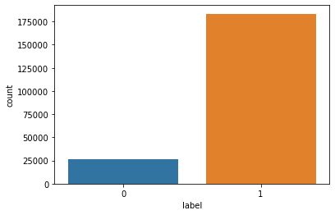
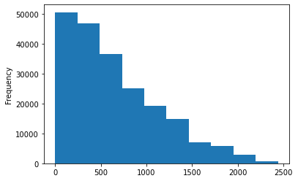
Label
Flag indicating whether the user paid back the credit amount within 5 days of issuing the loan{1:success, 0:failure}
Aon
age on cellular network in days
Considering the company is 25years old, the age on cellular network in days should be below 9130 days. Hence replacing age >9130 with the mean of the column
As number of days should be preferably in whole numbers, hence converted to int datatype
183431 customers are Non-defaulters
26162 customers are Defaulters
The dataset is imbalanced and will be down-sampled later
Majority customers have 660 days age on cellular network

Slide 10
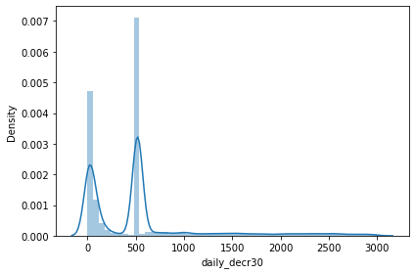
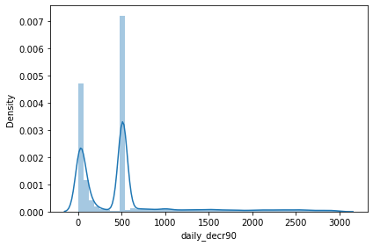
daily_decr30
Daily amount spent from main account, averaged over last 30 days (in Indonesian Rupiah)
daily_decr90
Daily amount spent from main account, averaged over last 90 days (in Indonesian Rupiah)
Daily amount spent from main account, averaged over last 30 days (in Indonesian Rupiah) should not be more than 3000. Hence replacing amount >3000 with the mean of the column
Daily amount spent from main account, averaged over last 90 days (in Indonesian Rupiah) should not be more than 3000. Hence replacing amount >3000 with the mean of the column
Majority customers have daily spent amount as 0 or 520
Majority customers have daily spent amount as 0 or 511

Slide 11
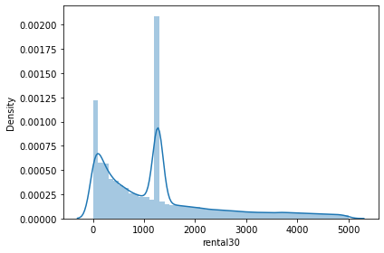
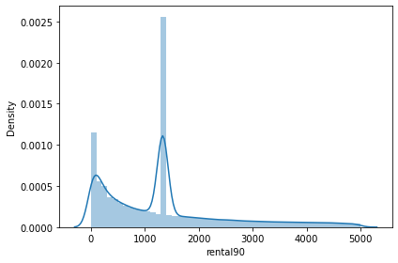
Rental30
Average main account balance over last 30 days
Rental90
Average main account balance over last 90 days
Average rental should not be <0 and should not be greater than 5000. Hence replacing absurd values with the mean of the column
Average rental should not be <0 and should not be greater than 5000. Hence replacing absurd values with the mean of the column
Majority customers have average rental as 0 or 1272
Majority customers have average rental as 0 or 1332

Slide 12
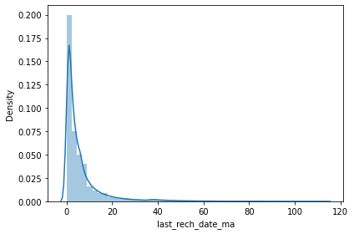
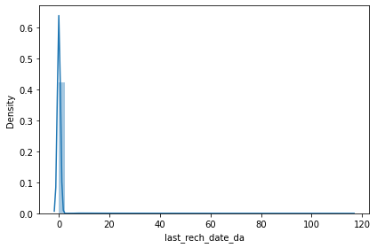
last_rech_date_ma
Number of days till last recharge of main account
last_rech_date_da
Number of days till last recharge of data account
Last recharge date should be as old as the company is, approx, 25 years, i.e., 9130 days. Hence replacing age >9130 with the mean of the column
Last recharge date should be as old as the company is, approx, 25 years, i.e., 9130 days. Hence replacing age >9130 with the mean of the column
As number of days should be preferably in whole numbers, hence converted to int datatype
As number of days should be preferably in whole numbers, hence converted to int datatype
Majority customers have 0-4 days till the last recharge
Majority customers have 0 days till the last recharge

Slide 13
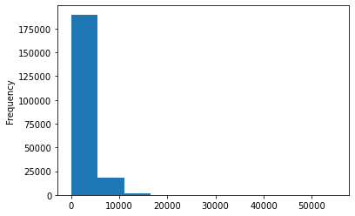
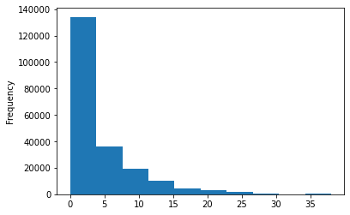
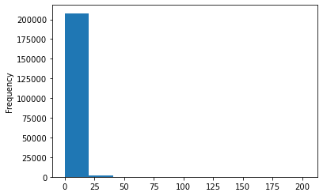
last_rech_amt_ma
Amount of last recharge of main account (in Indonesian Rupiah)
fr_ma_rech30
Frequency of main account recharged in last 30 days
Frequency of times data account got recharged in last 30 days should not be more than 3000. Hence replacing frequency >3000 with the mean of the column
Majority customers have last recharge amount of main account as 0 or 2300
cnt_ma_rech30
Number of times main account got recharged in last 30 days
Majority customers have main account recharge frequency between 1-15 times
Majority customers have recharged main account 0-4 days in last 30 days

Slide 14
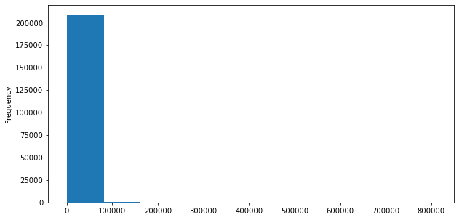
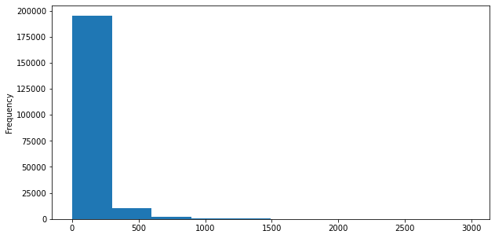
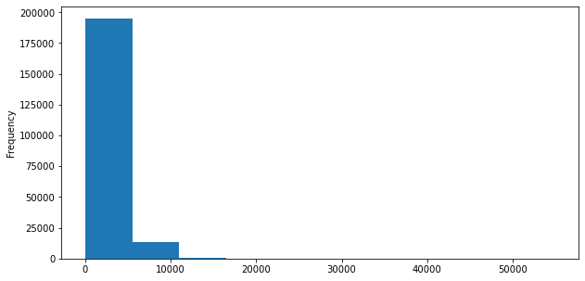
sumamnt_ma_rech30
Total amount of recharge in main account over last 30 days (in Indonesian Rupiah)
medianmarechprebal30
Median of main account balance just before recharge in last 30 days at user level (in Indonesian Rupiah)
Median of main account balance just before recharge in last 30 days at user level (in Indonesian Rupiah) should not be more than 3000. Hence replacing amount >3000 with the mean of the column
Majority customers have total recharge amount of main account of 0 Rupiah
medianamnt_ma_rech30
Median of amount of recharges done in main account over last 30 days at user level (in Indonesian Rupiah)
Majority customers have Median of main account balance just before recharge in last 30 days at user level is between 0-250
Majority customers median of amount of recharges done in main account in last 30 days between 0-6000

Slide 15
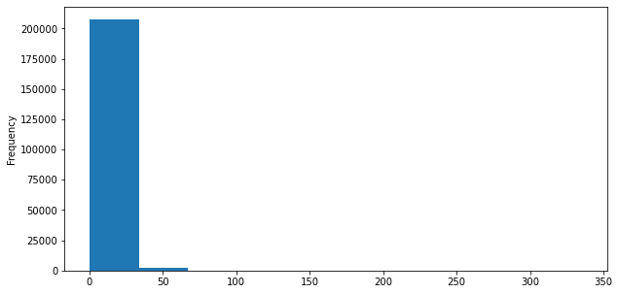
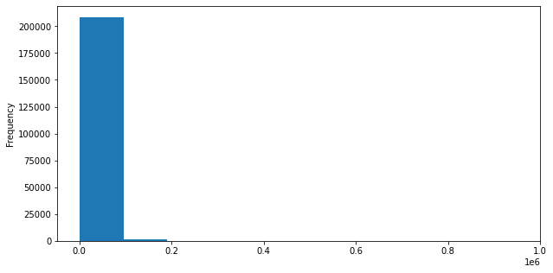
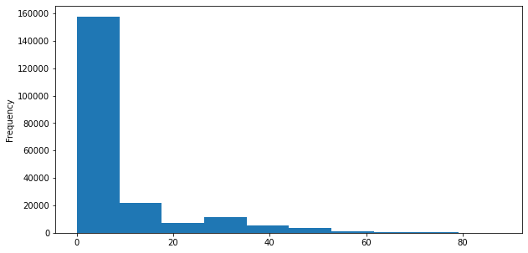
cnt_ma_rech90
Number of times main account got recharged in last 90 days
sumamnt_ma_rech90
Total amount of recharge in main account over last 90 days (in Indonesian Rupiah)
Majority customers have total recharge amount of main account of 0 Rupiah
Majority customers have recharged main account 0-4 times in last 90 days
medianamnt_ma_rech90
Median of amount of recharges done in main account over last 90 days at user level (in Indonesian Rupiah)
fr_ma_rech90
Frequency of main account recharged in last 90 days
Majority customers median of amount of recharges done in main account in last 90 days between 0-6000
Majority customers have main account recharge frequency between 1-15 times

Slide 16
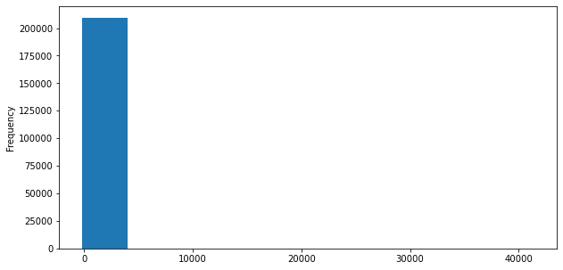
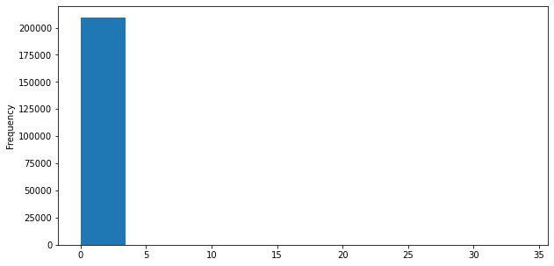
cnt_da_rech30
Number of times data account got recharged in last 30 days
medianmarechprebal90
Median of main account balance just before recharge in last 90 days at user level (in Indonesian Rupiah)
Number of times data account got recharged in last 30 days should not be more than 3000. Hence replacing number of times >3000 with the mean of the column
As number of times should be preferably in whole numbers, hence converted to int datatype
Majority customers have Median of main account balance just before recharge in last 90 days at user level is between 0-250
Majority of customers have recharged their data account 0-1 time

Slide 17
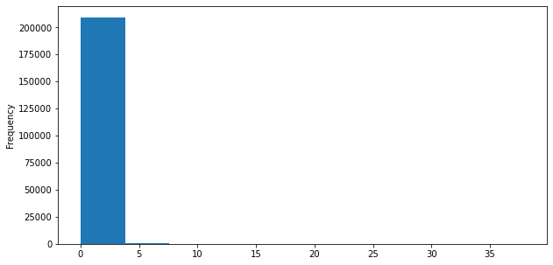
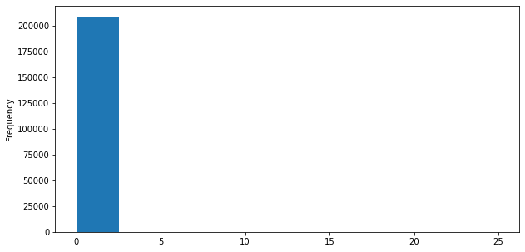
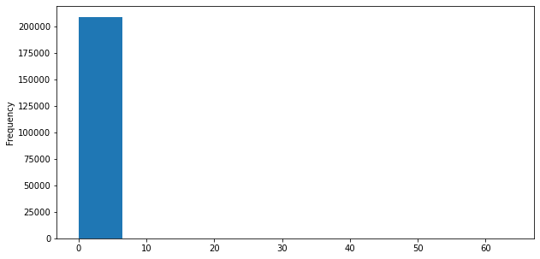
cnt_da_rech90
Number of times data account got recharged in last 90 days
fr_da_rech30
Frequency of data account recharged in last 30 days
Frequency of times data account got recharged in last 30 days should not be more than 3000. Hence replacing frequency >3000 with the mean of the column
Majority customers have recharged data account 0-1 times in last 90 days
fr_ma_rech90
Frequency of data account recharged in last 90 days
Majority customers have data account recharge frequency of 0 times
Majority customers have data account recharge frequency of 0 times

Slide 18
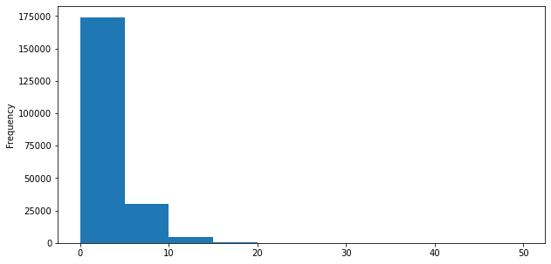
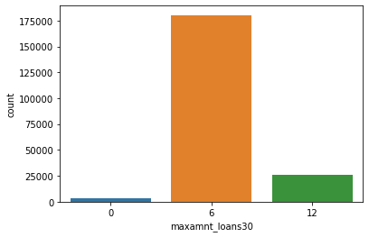
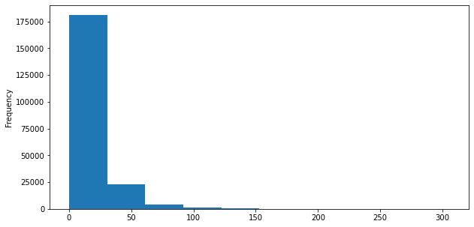
cnt_loans30
Number of loans taken by user in last 30 days
maxamnt_loans30
maximum amount of loan taken by the user in last 30 days
Maximum amount of loan taken by the user in last 30 days should be 0,6 or12. Hence replacing absurd amount >3000 with the mode of the column
Majority customers have taken 0-10 loans in last 30 days
As max amount should be preferably in whole numbers, hence converted to int datatype
amnt_loans30
Total amount of loans taken by user in last 30 days
Majority customers have taken 0-30 loans in last 30 days
Majority customers have maximum amount of loan taken by the user in last 30 days as 6

Slide 19
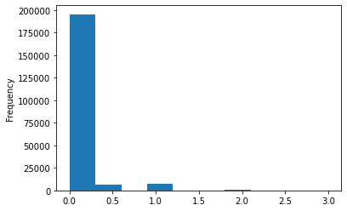
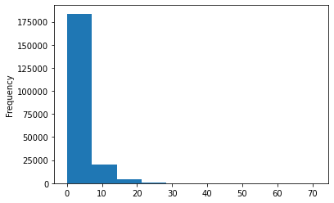
cnt_loans90
Number of loans taken by user in last 90 days
medianamnt_loans30
Median of amounts of loan taken by the user in last 30 days
Number of loans taken by user in last 90 days should be less than 300. Hence replacing number>300 with the mean of the column
As max number should be in whole numbers, hence converted to int datatype
Majority customers have median of amounts of loan taken by the user in last 30 days as 0
Majority customers have taken 0-5 loans in last 90 days

Slide 20
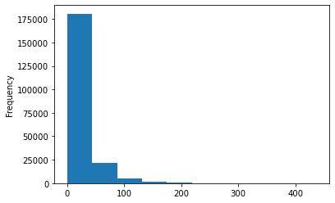


amnt_loans90
Total amount of loans taken by user in last 90 days
medianamnt_loans90
Median of amounts of loan taken by the user in last 90 days
Majority customers have taken 0-30 loans in last 30 days
maxamnt_loans90
maximum amount of loan taken by the user in last 90 days
Majority customers have median of amounts of loan taken by the user in last 90 days as 0
Majority customers have maximum amount of loan taken by the user in last 90 days as 6

Slide 21
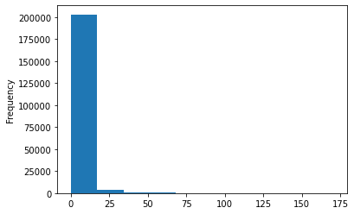
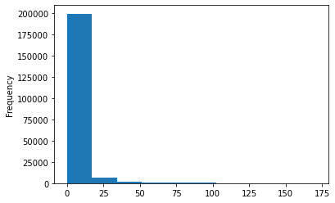
Payback30
Average payback time in days over last 30 days
Payback90
Average payback time in days over last 90 days
As days should be in whole numbers, hence converted to int datatype
As days should be in whole numbers, hence converted to int datatype
Majority customers have 0-15 days average payback time over last 30 days
Majority customers have 0-15 days average payback time over last 30 days

Slide 22
Statistical Analysis using Describe method-
label
count 209593.0000
mean 0.875177
std 0.330519
min 0.000000
25% 1.000000
50% 1.000000
75% 1.000000
max 1.000000
aon
count 209593.0000
mean 660.200880
std 493.406361
min 1.000000
25% 252.000000
50% 537.000000
75% 957.000000
max 2440.000000
daily_decr30
count 209593.0000
mean 520.427440
std 619.024143
min 0.000000
25% 45.500000
50% 520.427440
75% 520.427440
max 3000.000000
daily_decr90
count 209593.00000
mean 511.04720
std 610.80538
min 0.00000
25% 45.79200
50% 511.04720
75% 511.04720
max 3000.00000
rental30
count 209593.0000
mean 1272.025581
std 1169.950934
min 0.000000
25% 329.980000
50% 1218.580000
75% 1584.360000
max 5000.000000
rental90
count 209593.0000
mean 1332.011362
std 1166.600553
min 0.000000
25% 380.130000
50% 1332.011362
75% 1596.550000
max 4999.990000
last_rech_date_ma
count 209593.0000
mean 6.14886
std 9.33035
min 0.00000
25% 1.00000
50% 3.00000
75% 7.00000
max 113.00000
last_rech_date_da
count 209593.000000
mean 0.930518
std 7.028073
min 0.000000
25% 0.000000
50% 0.000000
75% 0.000000
max 115.000000

Slide 23
last_rech_amt_ma
count 209593.0000
mean 2064.452797
std 2370.786034
min 0.000000
25% 770.000000
50% 1539.000000
75% 2309.000000
max 55000.000000
cnt_ma_rech30
count 209593.0000
mean 3.978057
std 4.256090
min 0.000000
25% 1.000000
50% 3.000000
75% 5.000000
max 203.000000
fr_ma_rech30
count 209593.0000
mean 3.895563
std 5.426773
min 0.000000
25% 0.000000
50% 2.000000
75% 6.000000
max 38.000000
sumamnt_ma_rech30
count 209593.000000
mean 7704.501157
std 10139.621714
min 0.000000
25% 1540.000000
50% 4628.000000
75% 10010.000000
max 810096.000000
medianamnt_ma_rech30
count 209593.000000
mean 1812.817952
std 2070.864620
min 0.000000
25% 770.000000
50% 1539.000000
75% 1924.000000
max 55000.000000
medianmarechprebal30
count 209593.00000
mean 87.984085
std 176.261707
min 0.000000
25% 11.670000
50% 35.000000
75% 85.670000
max 2988.000000
cnt_ma_rech90
count 209593.0000
mean 6.31543
std 7.19347
min 0.00000
25% 2.00000
50% 4.00000
75% 8.00000
max 336.00000
fr_ma_rech90
count 209593.000000
mean 7.716780
std 12.590251
min 0.000000
25% 0.000000
50% 2.000000
75% 8.000000
max 88.000000

Slide 24
sumamnt_ma_rech90
count 209593.000000
mean 12396.218352
std 16857.793882
min 0.000000
25% 2317.000000
50% 7226.000000
75% 16000.000000
max 953036.000000
medianamnt_ma_rech90
count 209593.00000
mean 1864.595821
std 2081.680664
min 0.000000
25% 773.000000
50% 1539.000000
75% 1924.000000
max 55000.000000
medianmarechprebal90
count 209593.00000
mean 92.025541
std 369.215658
min -200.000000
25% 14.600000
50% 36.000000
75% 79.310000
max 41456.500000
cnt_da_rech30
count 209593.000000
mean 0.022944
std 0.267795
min 0.000000
25% 0.000000
50% 0.000000
75% 0.000000
max 34.000000
fr_da_rech30
count 209593.0000
mean 0.018039
std 0.442169
min 0.000000
25% 0.000000
50% 0.000000
75% 0.000000
max 25.000000
cnt_da_rech90
count 209593.0000
mean 0.041495
std 0.397556
min 0.000000
25% 0.000000
50% 0.000000
75% 0.000000
max 38.000000
fr_da_rech90
count 209593.0000
mean 0.045712
std 0.951386
min 0.000000
25% 0.000000
50% 0.000000
75% 0.000000
max 64.000000
cnt_loans30
count 209593.000000
mean 2.758981
std 2.554502
min 0.000000
25% 1.000000
50% 2.000000
75% 4.000000
max 50.000000

Slide 25
amnt_loans30
count 209593.0000
mean 17.952021
std 17.379741
min 0.000000
25% 6.000000
50% 12.000000
75% 24.000000
max 306.000000
maxamnt_loans30
count 209593.0000
mean 6.654554
std 2.147858
min 0.000000
25% 6.000000
50% 6.000000
75% 6.000000
max 12.000000
medianamnt_loans30
count 209593.0000
mean 0.054029
std 0.218039
min 0.000000
25% 0.000000
50% 0.000000
75% 0.000000
max 3.000000
cnt_loans90
count 209593.0000
mean 3.689408
std 4.016255
min 0.000000
25% 1.000000
50% 2.000000
75% 5.000000
max 71.000000
amnt_loans90
count 209593.0000
mean 23.645398
std 26.469861
min 0.000000
25% 6.000000
50% 12.000000
75% 30.000000
max 438.000000
maxamnt_loans90
count 209593.0000
mean 6.703134
std 2.103864
min 0.000000
25% 6.000000
50% 6.000000
75% 6.000000
max 12.000000
medianamnt_loans90
count 209593.0000
mean 0.046077
std 0.200692
min 0.000000
25% 0.000000
50% 0.000000
75% 0.000000
max 3.000000
payback30
count 209593.0000
mean 3.232226
std 8.762775
min 0.000000
25% 0.000000
50% 0.000000
75% 3.000000
max 171.000000
payback90
count 209593.0000
mean 4.126517
std 10.256986
min 0.000000
25% 0.000000
50% 1.000000
75% 4.000000
max 171.000000

Slide 26
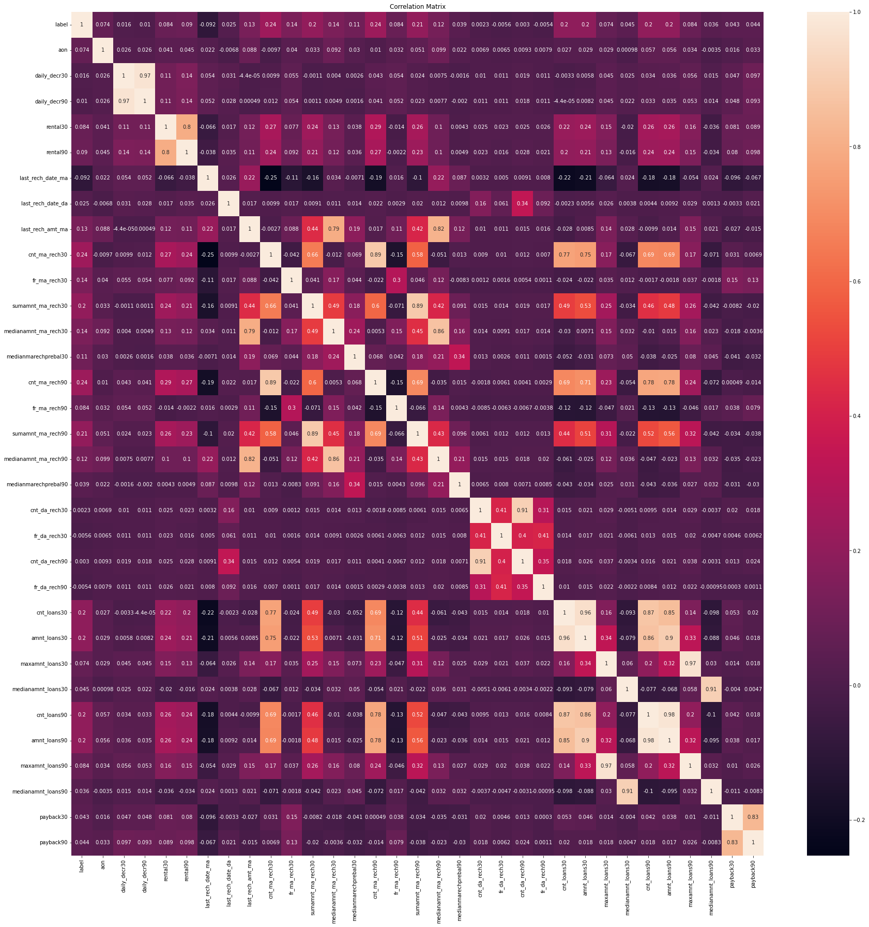
The Correlation Matrix using heatmap

Slide 27
Correlation between the columns and the label ‘label’ using corr method-
label - 1.000000
cnt_ma_rech30 - 0.237331
cnt_ma_rech90 - 0.236392
sumamnt_ma_rech90 - 0.205793
sumamnt_ma_rech30 - 0.202828
amnt_loans90 - 0.199788
cnt_loans90 - 0.199593
amnt_loans30 - 0.197272
cnt_loans30 - 0.196283
fr_ma_rech30 - 0.142612
medianamnt_ma_rech30 - 0.141490
last_rech_amt_ma - 0.131804
medianamnt_ma_rech90 - 0.120855
medianmarechprebal30 - 0.106691
rental90 - 0.090129
fr_ma_rech90 - 0.084385
maxamnt_loans90 - 0.084144
rental30 - 0.083731
maxamnt_loans30 - 0.073959
aon - 0.073587
medianamnt_loans30 - 0.044589
payback90 - 0.044201
payback30 - 0.043311
medianmarechprebal90 - 0.039300
medianamnt_loans90 - 0.035747
last_rech_date_da - 0.024841
daily_decr30 - 0.015940
daily_decr90 - 0.010440
cnt_da_rech90 - 0.002999
cnt_da_rech30 - 0.002333
fr_da_rech90 : -0.005418
fr_da_rech30 : -0.005563
last_rech_date_ma : -0.091982
fr_da_rech90, fr_da_rech30 and last_rech_date_ma are negatively correlated to ‘label, the others are positively correlated
cnt_ma_rech30 is 23.7% positively correlated
last_rech_date_ma is 9.1% negatively correlated

Slide 28
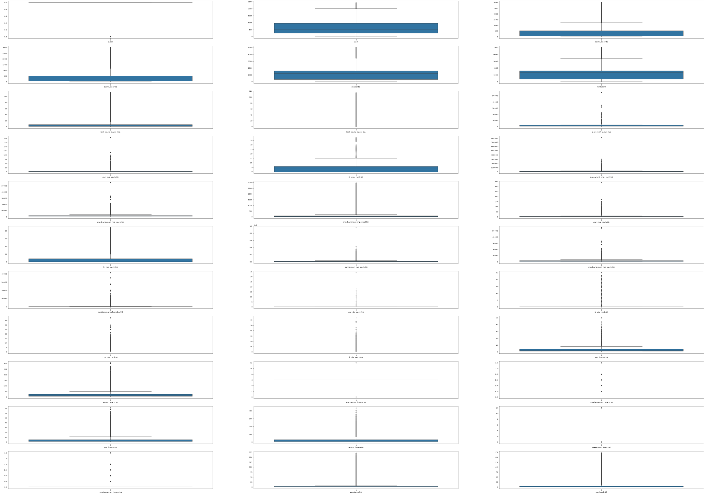
Visualizing outliers using boxplot method-

Slide 29


Slide 30
Removing outliers using zscore method-
On removing the outliers the data loss is 27.9%, which is not acceptable, hence outliers are tolerated
The dataset is divided into x(features) and y (label)-
The x contains all the features other than the label ‘label’
The y contains only the label ‘label’

Slide 31
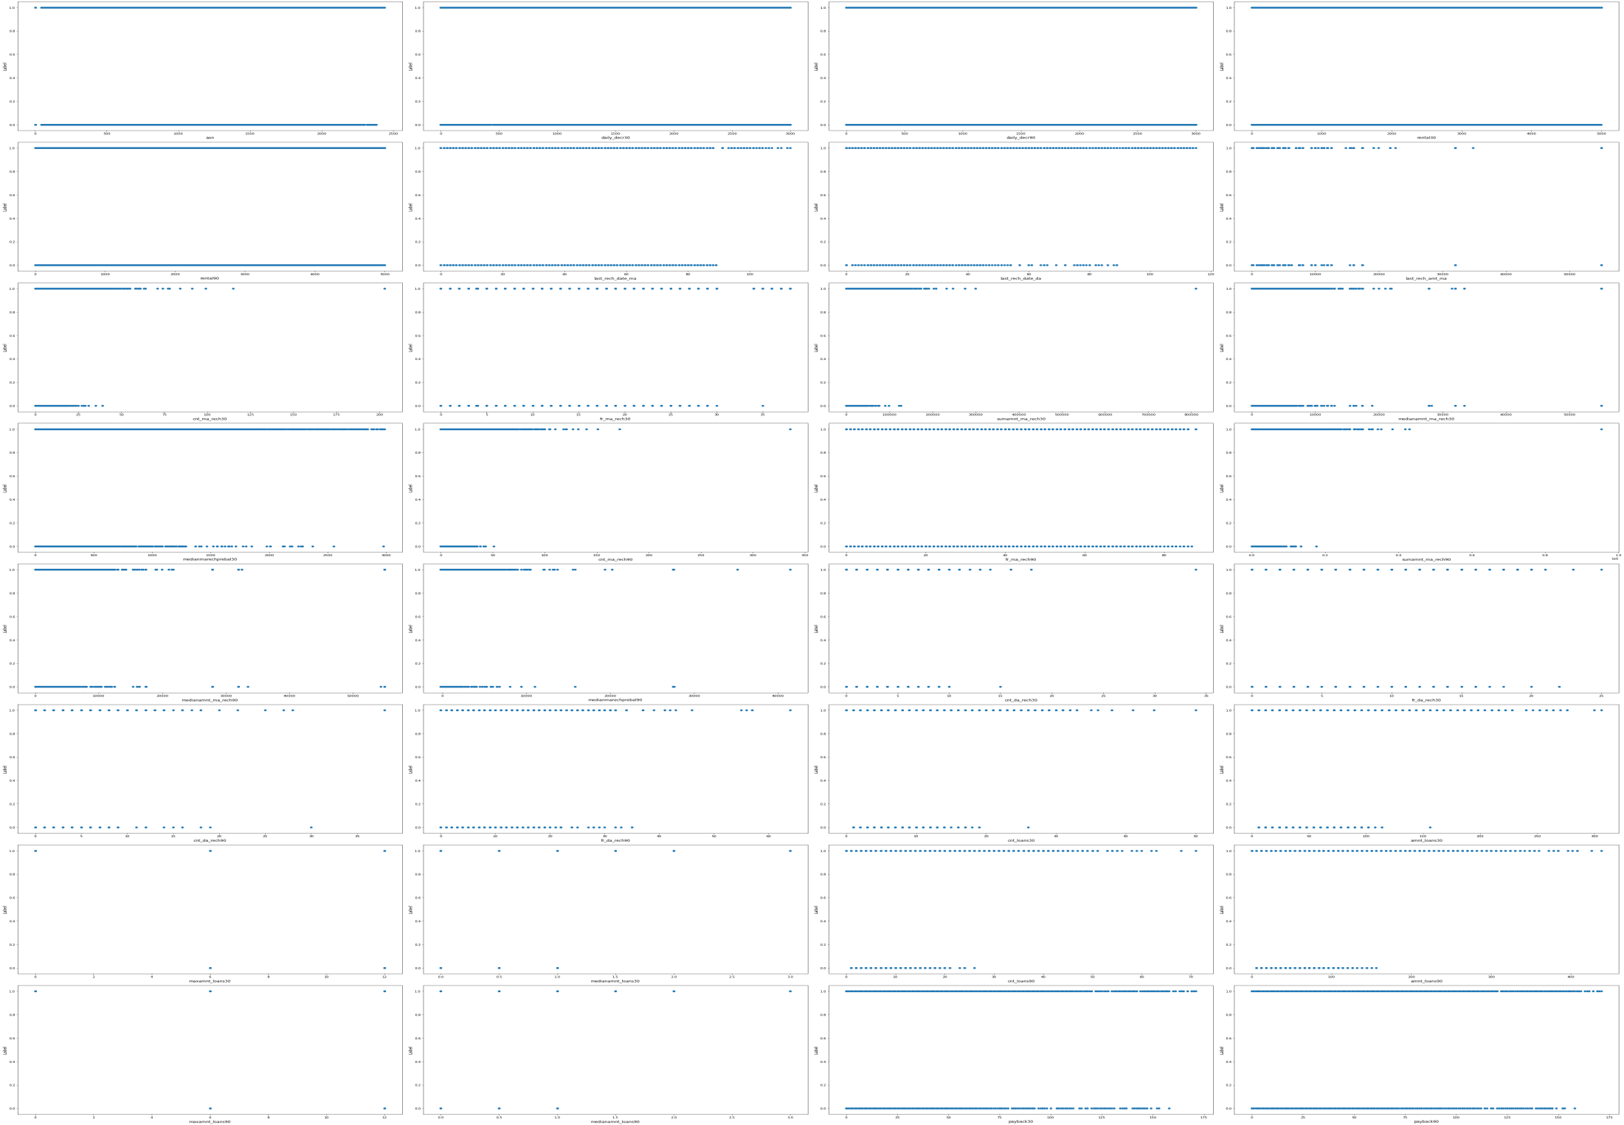
Visualizing relationship between features and label-

Slide 32
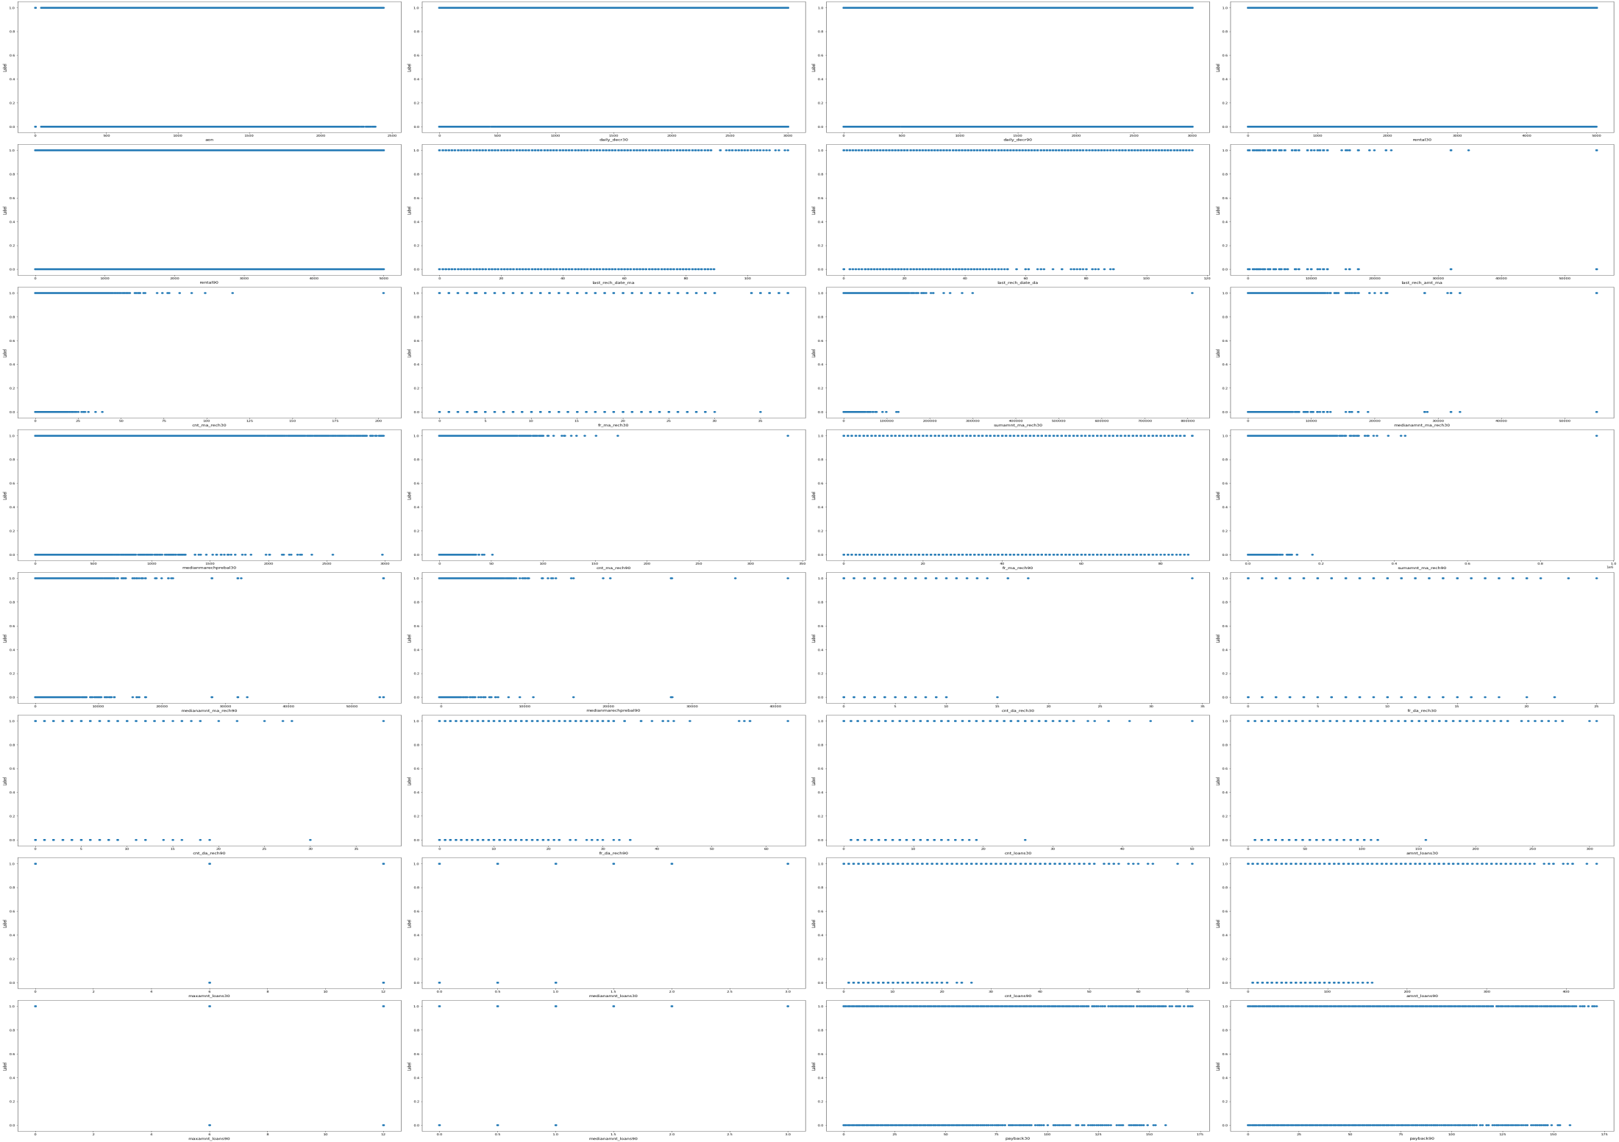

Slide 33
The skewness observed in graphical analysis was confirmed by using the skew method-
Driven km : 1.082297
Location : 0.801142
Model : 0.025468
Brand : 0.023501
Variant : -0.213326
Fuel : -0.277616
Manufacturing Year : -0.760945
Kind : -0.814154
This skewness was removed using the power transformer
The x(features) were scaled using the Standard Scaler
The dataset was divided into train and test set using train test split and the best random state was found to be 62

Slide 34
The skewness observed in graphical analysis was confirmed by using the skew method-
Medianmarechprebal90 - 44.880503
fr_da_rech30 - 31.164842
cnt_da_rech30 - 30.832071
fr_da_rech90 - 28.988083
cnt_da_rech90 - 27.267278
last_rech_date_da - 9.708988
Payback30 - 8.429388
Payback90 - 6.985942
sumamnt_ma_rech30 - 6.386787
Medianmarechprebal30- 6.166626
sumamnt_ma_rech90- 4.897950
medianamnt_loans90- 4.895720
medianamnt_loans30- 4.551043
last_rech_amt_ma- 3.781149
medianamnt_ma_rech90 - 3.752706
last_rech_date_ma - 3.583927
medianamnt_ma_rech30 - 3.512324
cnt_ma_rech90 - 3.425254
cnt_ma_rech30 - 3.283842
amnt_loans90 - 3.150006
cnt_loans90 - 3.004244
amnt_loans30 - 2.975719
cnt_loans30 0- 2.713421
fr_ma_rech90 - 2.285423
daily_decr90 - 2.096214
daily_decr30 - 2.050816
fr_ma_rech30 - 2.024554
maxamnt_loans90 - 1.678304
maxamnt_loans30 - 1.435587
rental30 - 1.256978
rental90 - 1.190303
aon - 0.959455
This skewness was removed using the power transformer
The x(features) were scaled using the Standard Scaler
The dataset was divided into train and test set using train test split and the best random state was found to be 170
The imbalanced dataset was downsampled using NearMiss as follows-
Original y_train-: {1: 146633, 0: 21041}
Downsampled y_train-: {1: 28054, 0: 21041}

Slide 35
The train and test data were applied on different models as follows

Slide 36
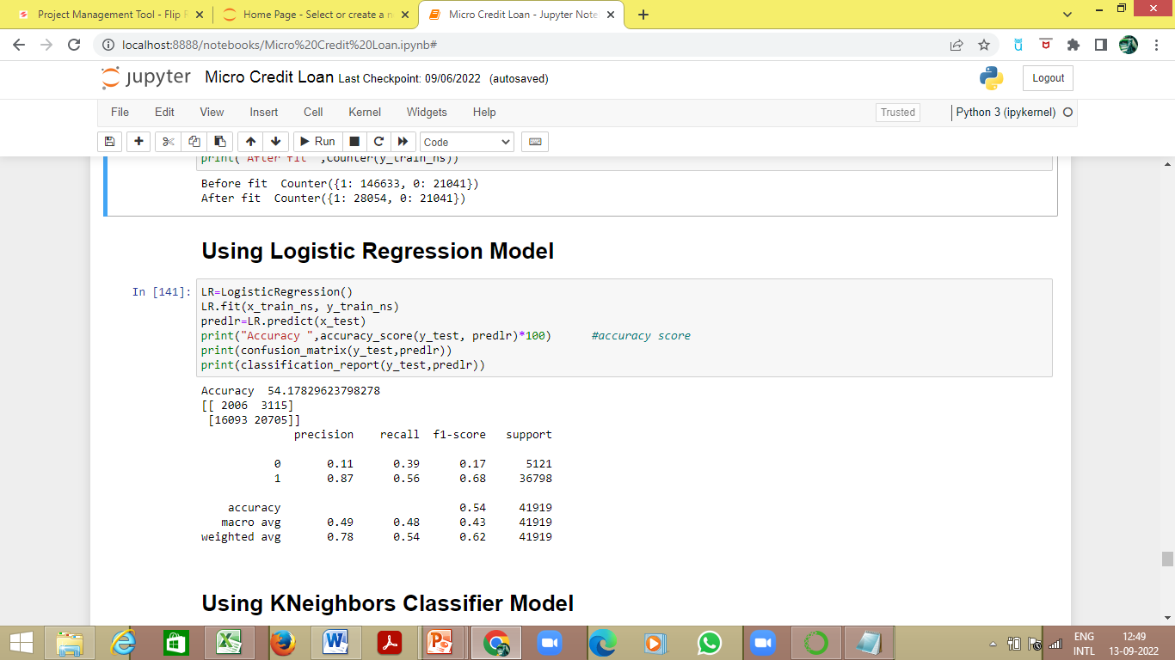
Logistic Regression Model
The Accuracy for target test and pred_test(data predicted on features_test) is 54.18%
The Confusion Matrix for target test and pred_test(data predicted on features_test) is –
The Classification Report for target test and pred_test(data predicted on features_test) is
True Positive
False Positive
2006 | 3115
16093 | 20705
False Negative
True Negative

Slide 37
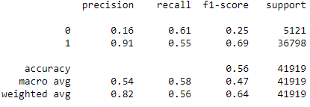
KNeighbors Classifier Model
The Accuracy for target test and pred_test(data predicted on features_test) is 56.09%
The Confusion Matrix for target test and pred_test(data predicted on features_test) is –
The Classification Report for target test and pred_test(data predicted on features_test) is
True Positive
False Positive
3128 | 1993
16410 | 20388
False Negative
True Negative

Slide 38

Decision Tree Classifier
The Accuracy for target test and pred_test(data predicted on features_test) is 43.29%
The Confusion Matrix for target test and pred_test(data predicted on features_test) is –
The Classification Report for target test and pred_test(data predicted on features_test) is
True Positive
False Positive
3471 | 1650
22121 | 14677
False Negative
True Negative

Slide 39
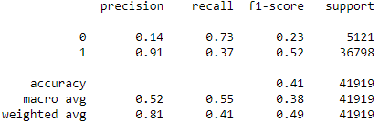
Random Forest Classifier
The Accuracy for target test and pred_test(data predicted on features_test) is 41.17%
The Confusion Matrix for target test and pred_test(data predicted on features_test) is –
The Classification Report for target test and pred_test(data predicted on features_test) is
True Positive
False Positive
3722 | 1399
23260 | 13538
False Negative
True Negative

Slide 40
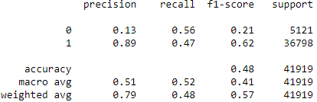
AdaBoost Classifier
The Accuracy for target test and pred_test(data predicted on features_test) is 48.39%
The Confusion Matrix for target test and pred_test(data predicted on features_test) is –
The Classification Report for target test and pred_test(data predicted on features_test) is
True Positive
False Positive
2886 | 2235
19396 | 17402
False Negative
True Negative

Slide 41
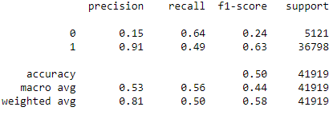
Gradient Boosting Classifier
The Accuracy for target test and pred_test(data predicted on features_test) is 50.39%
The Confusion Matrix for target test and pred_test(data predicted on features_test) is –
The Classification Report for target test and pred_test(data predicted on features_test) is
True Positive
False Positive
3263 | 1858
18934 | 17864
False Negative
True Negative

Slide 42
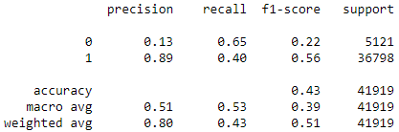
SVC
The Accuracy for target test and pred_test(data predicted on features_test) is 43.39%
The Confusion Matrix for target test and pred_test(data predicted on features_test) is –
The Classification Report for target test and pred_test(data predicted on features_test) is
True Positive
False Positive
3346 | 1775
21952 | 14846
False Negative
True Negative

Slide 43
Cross Validation
Model | Cross Validation Score
Logistic Regression | 0.8749
KNeighbor Classifier | 0.8815
Decision Tree Classifier | 0.8630
Random Forest Classifier | 0.9104
Ada Boost Classifier | 0.8972
Gradient Boost Classifier | 0.9079
Random Forest Classifier is performing better, hence it is carried forward

Slide 44
Hyperparameter tuned Random Forest Classifier Model on Downsampled Data
Random Forest Classifier Model is hyperparameter tuned using GridSearchCV
The best parameters for criterion, max_depth and max_features are found as follows-
criterion: gini
max_depth: 8
Max_features: auto
Applying the above found best parameters on Random Forest Classifier Model, the following was obtained-
The Accuracy for target test and pred_test(data predicted on features_test) is 52.07%

Slide 45
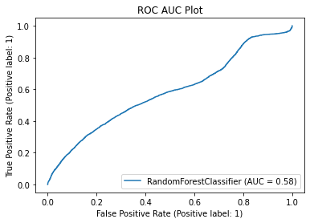
The ROC AUC Plot on the Hyperparameter tuned Random Forest Classifier Model on Downsampled Data
Final Accuracy is 52% and AUC score is 58%, which depicts that our model is working okay

Slide 46
Hyperparameter tuned Random Forest Classifier Model on Original Data
Random Forest Classifier Model is hyperparameter tuned using GridSearchCV
The best parameters for criterion, max_depth and max_features are found as follows-
criterion: gini
max_depth: 8
Max_features: log2
Applying the above found best parameters on Random Forest Classifier Model, the following was obtained-
The Accuracy for target test and pred_test(data predicted on features_test) is 90.74%

Slide 47
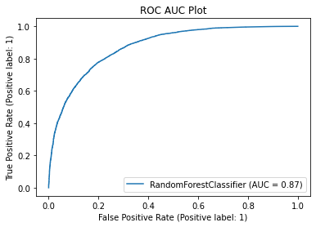
The ROC AUC Plot on the Hyperparameter tuned Random Forest Classifier Model on Original Data
Final Accuracy is 90.74% and AUC score is 87%, which depicts that our model is working well
However, as the original dataset was imbalanced, working on the downsampled data is safer, even though its accuracy is not satisfactory

